Slide 1
DEVICE DRIVERS
Presented By
Vijay Dhoki
Keerthi Kumari Cheguri
Mounika Gopagani
Chaithanya Mekala
Lajul Soni
Toncy G John

Slide 2
Contribution for March
TASK DONE :
Builded Qualcomm msm8905 code and flashed it into device using QFIL Tool.
Collected device logs using adb commands.
Worked on Device drivers Concepts.
Studied about the types of RAM's present .
Presented By
CURRENT TASK :
Vijay Dhoki
Creating panic in raspberrypi driver.

Slide 3
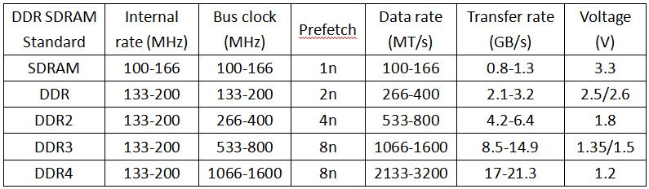

Slide 4
Contribution for March
TASK DONE :
Builded Qualcomm msm8905 code and flashed it into device using QFIL Tool.
Collected device logs using adb commands.
Worked on Device drivers Concepts.
Studied about the device tree.
Presented By
CURRENT TASK :
MOUNIKA GOPAGANI
Creating panic in raspberrypi driver.

Slide 5
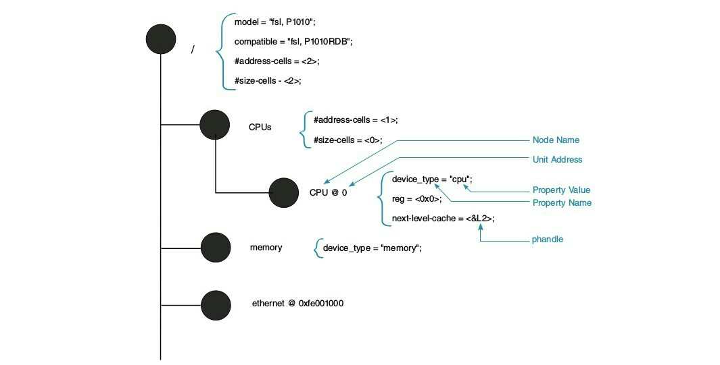

Slide 6
Contribution for March
TASK DONE :
Builded Qualcomm msm8905 code and flashed it into device using QFIL Tool
Collected device logs using adb commands
Worked on Device drivers Concepts
Studied about differnt types of ARM Exceptions
CURRENT TASK :
Creating panic in raspberrypi driver
Presented By
C.KEERTHI KUMARI

Slide 7
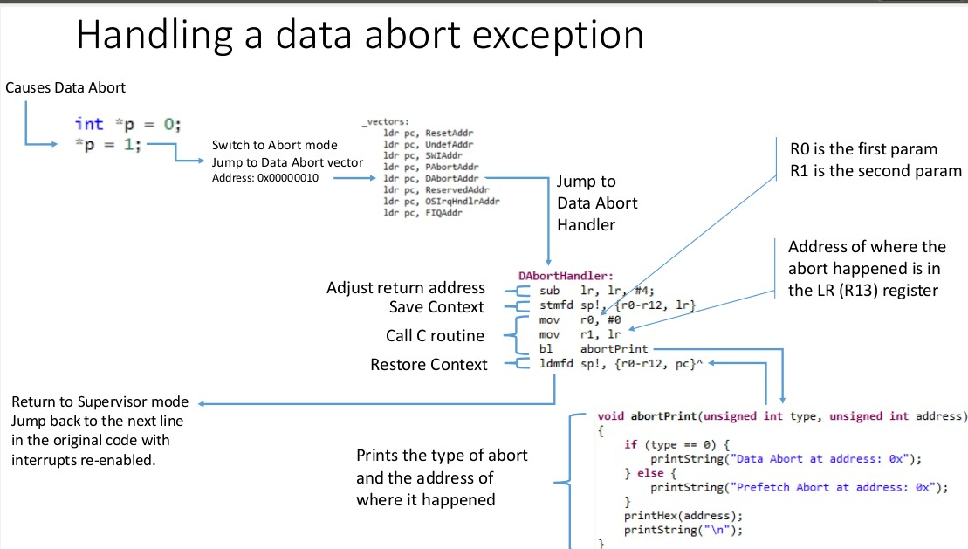

Slide 8
Contribution for March
TASK DONE :
Builded Qualcomm msm8905 code and flashed it into device using QFIL Tool.
Collected device logs using adb commands.
Worked on Device drivers Concepts.
Studied about the boot flow .
Presented By
CURRENT TASK :
CHAITHANYA MEKALA
Creating panic in raspberrypi driver.

Slide 9
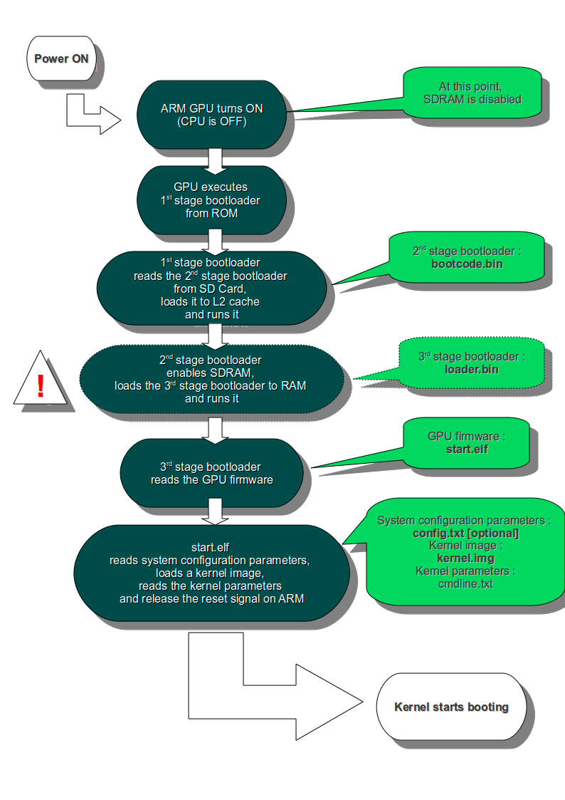

Slide 10
Contribution For March Month
Task Done:
1. what is kernel panic.
2. Reason for kernel panic.
3. create kernel oops.
Current Task:
1. Have to create kernel panic in raspberry pi driver .
New Learned:
1. How to read logs.
2. How to work with our own module.
Presented By
Lajul soni

Slide 11
KERNEL BUILDING, BOARD BRINGUP & DHT11
Building a new or custom kernel for RPi using cross compilation.
Going through the contents of boot and root partitions.
Checking out the boot sequence.
Checking out DHT11 hardware overlay.
Working and communication protocol of DHT11.
Fixing bugs in Qualcomm source code.
Presented By
Toncy John

Slide 12
THANK YOU......

